Slide 1



WIRELESS CHARGER
Pralhad KaraD 112107027
Janhavi Kulkarni 112107030
Abhishek Mane 112107034
Under the guidance of
Prof. Ms. D. V. Niture

Slide 2

CONTENT
∙ INTRODUCTION
∙ AIM
∙ OBJECTIVE
∙ COMPONENTS
∙ CIRCUIT DIAGRAM
∙ CONCLUSION
∙ REFERENCES

Slide 3
INTRODUCTION
Wireless charging, also known as inductive charging, utilizes the principles of electromagnetic induction to transfer power wirelessly between a charger (transmitter) and a compatible device (receiver). It relies on the concept of creating a magnetic field to induce an electric current in a nearby receiver, enabling the charging process.

Slide 4
AIM
∙ To design a wireless charger.
∙ The aim of this project is to demonstrate the concept of wireless mobile
charging system using the principle of inductive coupling.
OBJECTIVE
∙ Aimed at eliminating the problems of wired technology and demonstrating the
easiness of wireless communication systems promoting greater convenience and
ubiquity for charging everyday devices.
∙ By designing and constructing a method by circuit to transmit electrical power
wirelessly from source to device, we will eliminate the use of cables in the charging
process, thus making it simpler and easier to charge a low power device.

Slide 5
COMPONENTS
1. IN4007 Diode
2. Resistors
3. Capacitors
4. Switch
5. Voltage Regulator IC’s
6. Enamelled Copper Wire
7. Transformer
8. Connectors
9. Breadboard

Slide 6
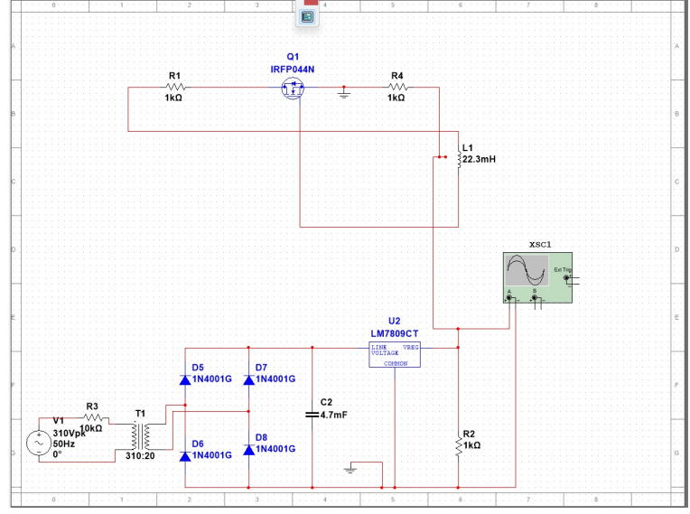
CIRCUIT DIAGRAMS
TRANSMITTER
CIRCUIT

Slide 7
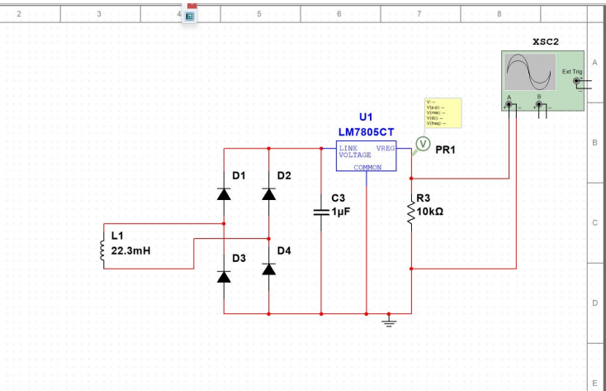
RECIEVER CIRCUIT

Slide 8
CONCLUSION
∙ In conclusion, wireless chargers offer a convenient and cable-free way to charge compatible devices.
∙ With the increasing availability and compatibility of wireless charging technology, it has become a popular
choice for users seeking a hassle-free charging experience.
∙ As technology continues to advance, we can expect further improvements in efficiency and charging speeds,
making wireless charging an even more viable and widespread option in the future

